Slide 1
Predicting Influencers in a Social Network
Group 11
Akshay Mehra
Sayam Ganguly
Patrick Green

Slide 2
Objective
Problem Definition
Predict the human judgement about which of two users is more influential in a social network, given twitter activity data for the pair.
Data Set
Numeric features for pairs of users (A and B). Both training and test data sets provided.
Follower/Following Count
Mentions Sent/Received
Retweets Sent/Received
Post Count
Listed Count (count of inclusion in user-created categories or lists)
Network Features (proprietary calculated features)

Slide 3
Approach
Pre-processing
Feature Selection – determine which features correlate with influence
Feature Transformations – normalize data
Modeling Methods
Logistic Regression
Neural Network
Support Vector Machines (SVM)
Ensemble
Evaluation
Measuring the area under the Receiver Operating Characteristic (ROC) curve, which plots true positives against false positives for probabilistic outcomes for a range of thresholds. (TODO – Add Sample Curve)
Baseline Solution:
The person who has more followers is the person who is more influential. (Area Under Curve : 0.75175)

Slide 4
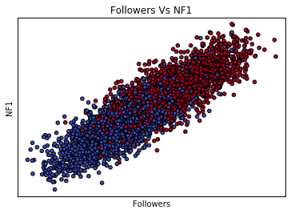
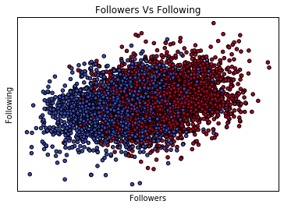
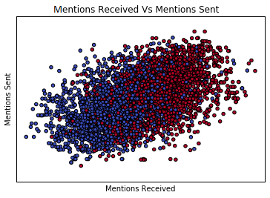
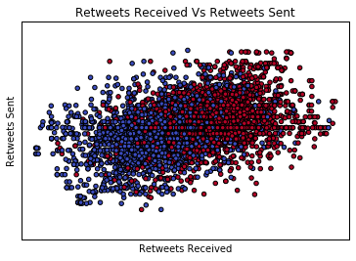
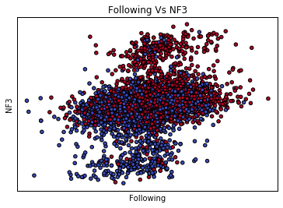
Data Visualization

Slide 5
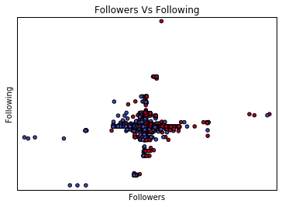
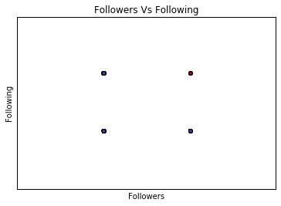
Feature Transformation
Delta Transform
Absolute difference between values for two users
Baseline
Preserves the meaning of large difference in values
To reduce the scale of the data, we normalize it.
Binary Transform
Reduce difference to one (larger for user A) or zero (larger for user B)
Simpler data set, but discards the magnitude of differences
Logarithm
Reduces large differences in the orders of magnitude in features (ie. follower versus following counts)
Simplifies non-linear relationships between input and output.

Slide 6
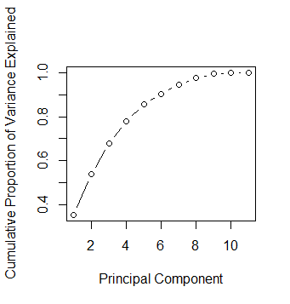
Feature Selection
Principle Component Analysis
Principal Component 1
A_follower_count - B_follower_count | -0.35497
A_following_count - B_following_count | -0.06158
A_listed_count - B_listed_count | -0.43547
A_mentions_received - B_mentions_received | -0.46721
A_retweets_received - B_retweets_received | -0.46998
A_mentions_sent - B_mentions_sent | -0.05578
A_retweets_sent - B_retweets_sent | -0.07444
A_posts - B_posts | -0.06964
A_network_feature_1 - B_network_feature_1 | -0.47135
A_network_feature_2 - B_network_feature_2 | 0.063936
A_network_feature_3 - B_network_feature_3 | 0.040503
Importance of components:
 | PC1 | PC2 | PC3 | PC4 | PC5 | PC6 | PC7 | PC8 | PC9 | PC10 | PC11
Standard deviation | 1.9736 | 1.4221 | 1.249 | 1.04245 | 0.9197 | 0.73123 | 0.67873 | 0.57052 | 0.45938 | 0.21665 | 0.10378
Proportion of Variance | 0.3541 | 0.1839 | 0.1418 | 0.09879 | 0.0769 | 0.04861 | 0.04188 | 0.02959 | 0.01918 | 0.00427 | 0.00098
Cumulative Proportion | 0.3541 | 0.538 | 0.6798 | 0.77859 | 0.8555 | 0.9041 | 0.94598 | 0.97557 | 0.99475 | 0.99902 | 1

Slide 7
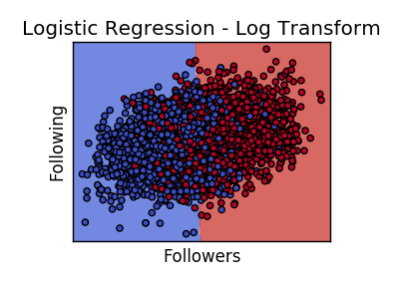
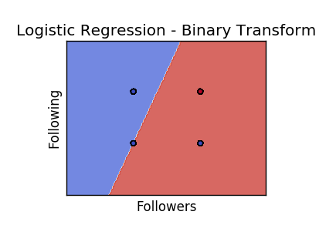
Models – Logistic Regression

Slide 8
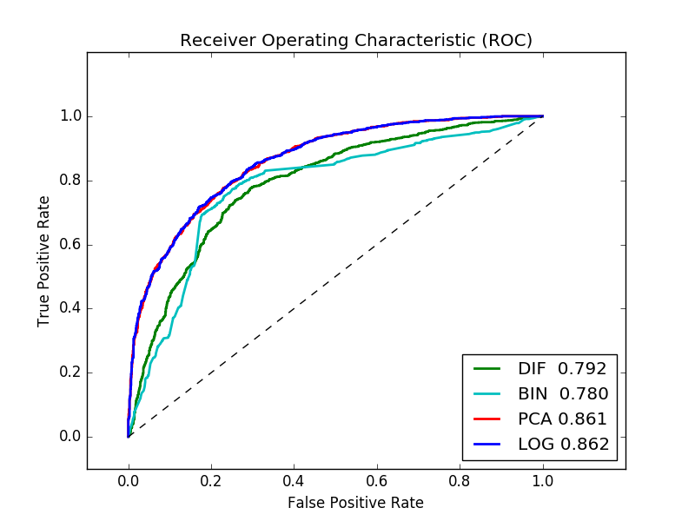
Models – Logistic Regression

Slide 9
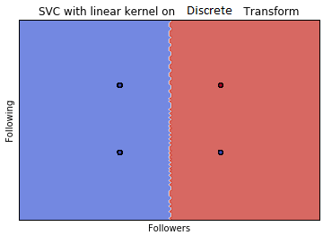
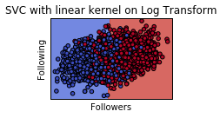
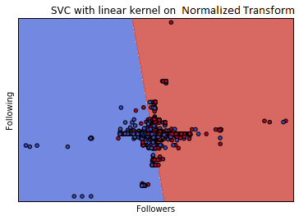
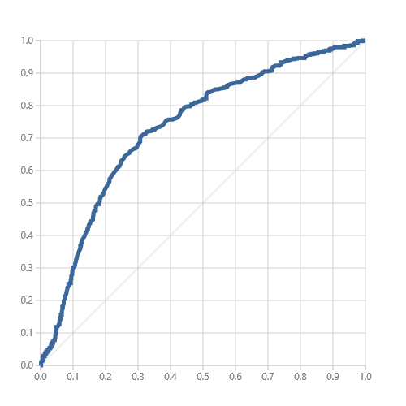
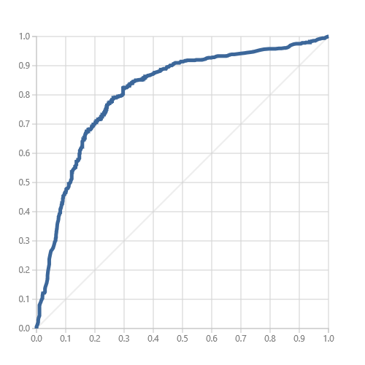
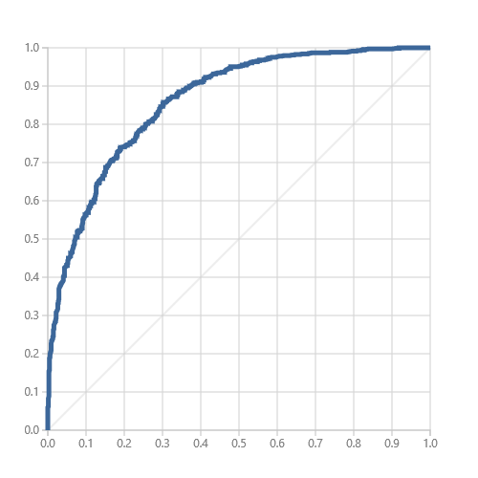
Models
SVM
Graphs on data transform
True Positive Rate
True Positive Rate
True Positive Rate
AUC:0.800586
AUC:0.86057
AUC:0.729937
Test AUC:0.8129
Test AUC:0.85931
Test AUC:0.71758
False Positive Rate
False Positive Rate
False Positive Rate

Slide 10
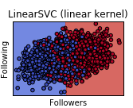
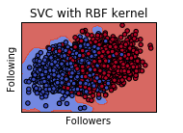
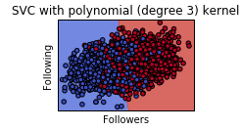
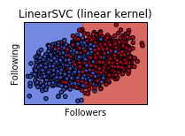
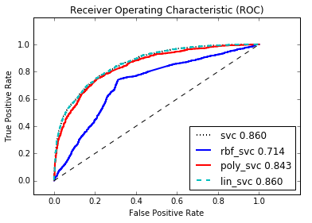
SVM
Graphs tweaking performance
Talk about Overfitting

Slide 11
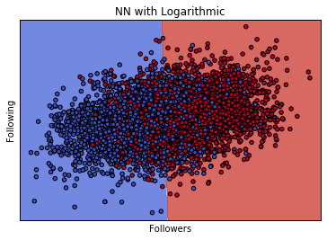
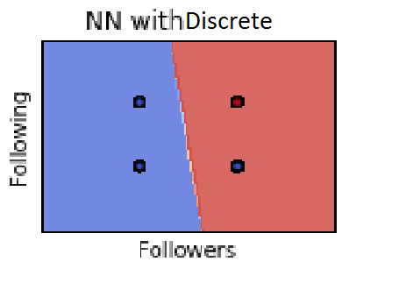
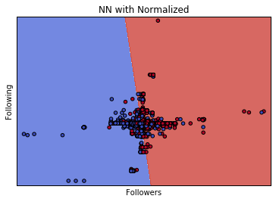
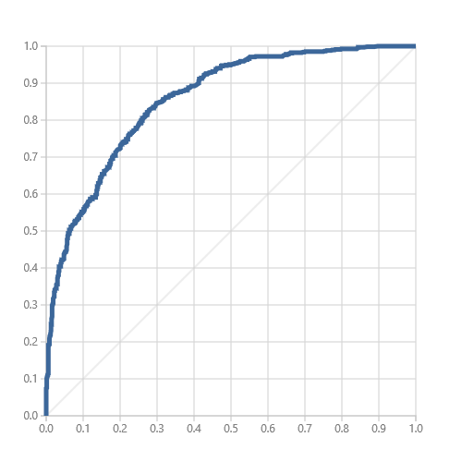
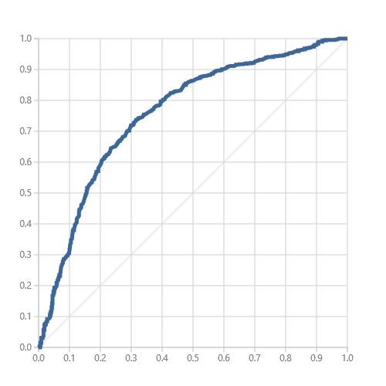
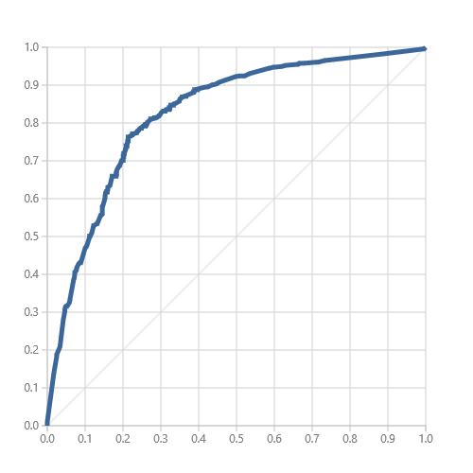
Models
NN
Graphs on data transform
AUC:86.19
Test AUC: 86
AUC:75.8
Test AUC: 75.5
AUC: 82.5
Test AUC: 83

Slide 12
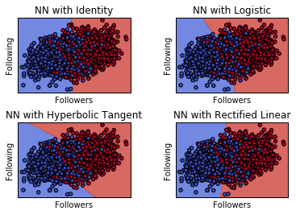
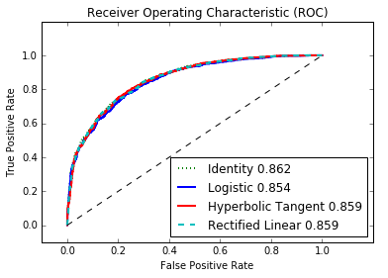
Models
NN
Graphs tweaking performance
Talk about Overfitting

Slide 13
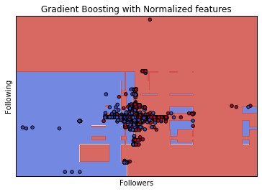
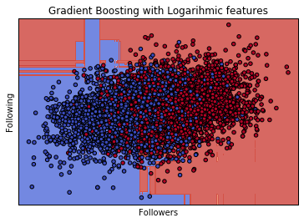
Models
Gradient Boosting
Graphs on data transform
Talk about Overfitting

Slide 14
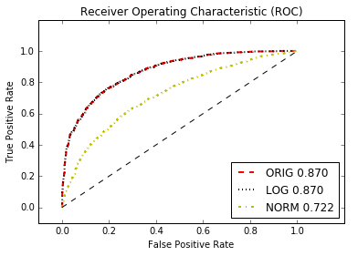
Models : Gradient Boosting ROC

Slide 15
Model Comparison
Compare Best Graphs with Accuracy (ROC)
Logistic
SVM
NN
Gradient Boosting
SVM: 0.86 (difference of Logs)
NN: 0.862(difference of Logs)
Gradient Boosting: 0.87 (Original Features 22 of them)
Logistic: 0.862(difference of Logs)

Slide 16
Conclusion
Talk about what worked and what did not

Slide 17
Thanks!!

